Slide 1

Introduction to AI Types of Agents SY B.Sc. (CS)
Semester VI
Poornima .N
Assistant Professor, Department of IT/CS
1

Slide 2

2 Topics:
Simple Reflex Agent
Model-Based Reflex Agent
Goal-Based Agent
Utility-Based Agent
Learning Agent
Characteristics of Intelligent agents
Do you know how machines take smart decisions just
like humans? Let’s see
how!

Slide 3

3 Agent Function vs Agent Program
Agent Function: The theoretical mapping from all percepts to all possible actions.
Agent Program: The actual code that runs on the architecture and uses the current percept.
Example:
Function: “If you’ve seen dirt in the last two moves, return there.”
Program: Keeps memory to recall past percepts.”

Slide 4
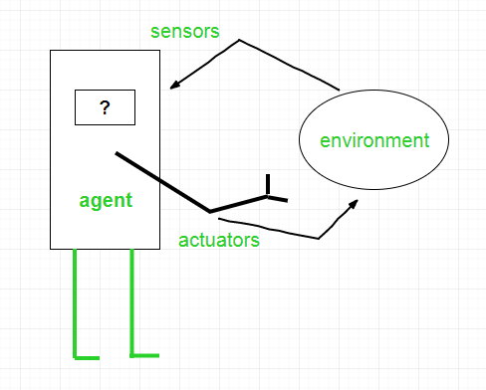

Slide 5
4 Simple Reflex Agent
Works on current percept only.
Uses condition–action rules.
Doesn’t consider history or future.
Example: “If dirt → then clean.” (Vacuum robot)
Formula:
if <condition> then <action>

Slide 6
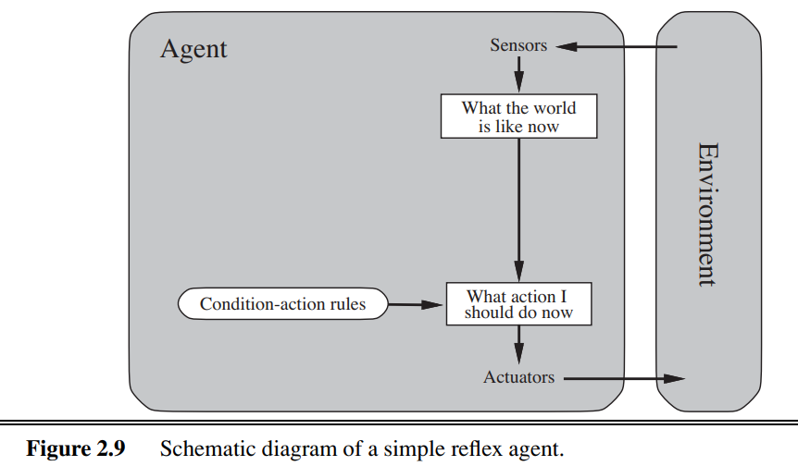

Slide 7
5 Activity 1
If traffic light is red → ________
If phone battery is low → ________
If camera detects fire → ________
If no motion detected for 10 mins → ________
If temperature keeps rising → ________
If my teacher looks at me → ________
If my friend sends meme → ________
If Wi-Fi disconnects → ________
If class ends → ________
If it’s Sunday → ________

Slide 8
6 Model-Based Reflex Agent
Has an internal model of the world.
Remembers what happened before (percept history).
Handles partial observability.
Old state + current percept + model of world.
Example: Self-driving car remembers the position of cars it cannot currently see.

Slide 9
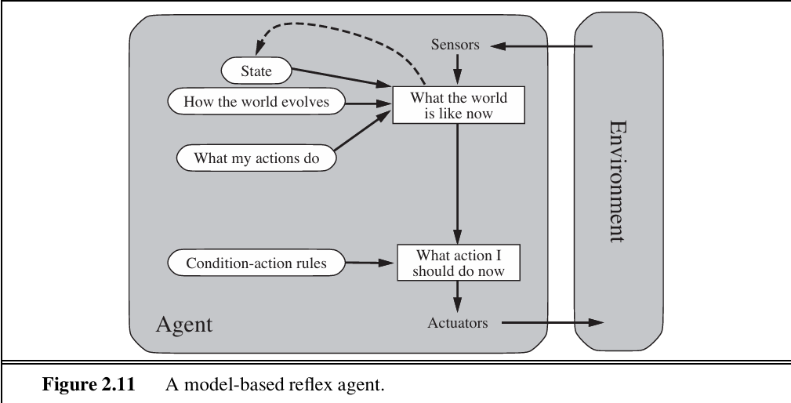

Slide 10
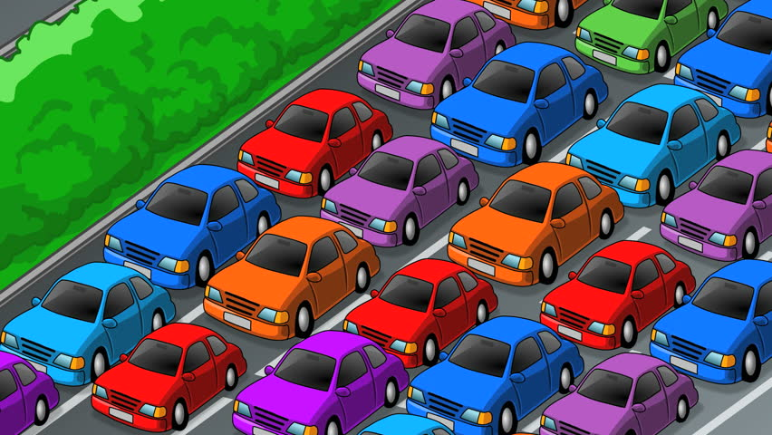
7 Activity 2.a What will your mind says when I say the word car?

Slide 11
8 Activity 2 examples
Percept | Model-Based Reflex Action
Traffic light is red | Stop if approaching intersection
Phone battery is low | Charge or save battery depending on usage
Camera detects fire | Raise alarm if not already raised
No motion detected for 10 mins | Turn off lights if room was occupied
Temperature keeps rising | Turn on AC if people are present
My teacher looks at me | Sit properly if slouching
Friend sends meme | Check phone if free
Wi-Fi disconnects | Reconnect if needed
Class ends | Leave if next class allows
It’s Sunday | Sleep or study depending on pending work

Slide 12
9 Activity 2
Situation | State/History to consider
Laptop overheating? | Is a long task running?
It starts raining? | ________
Room is dark? | Is anyone sleeping?
Doorbell rings? | ________
Pet is meowing? | Was it just fed or played with?
Washing machine done? | Is someone using the laundry area?
TV is on but no one watching? | ________
Garden plants look dry? | ________

Slide 13
10 Goal-Based Agent
Decides action based on goals (desired outcome).
Uses model of world + reasoning + planning.
More flexible than reflex agents.

Slide 14
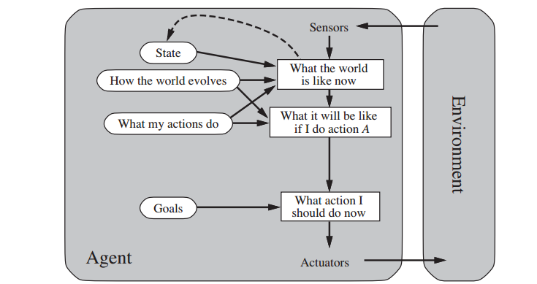

Slide 15
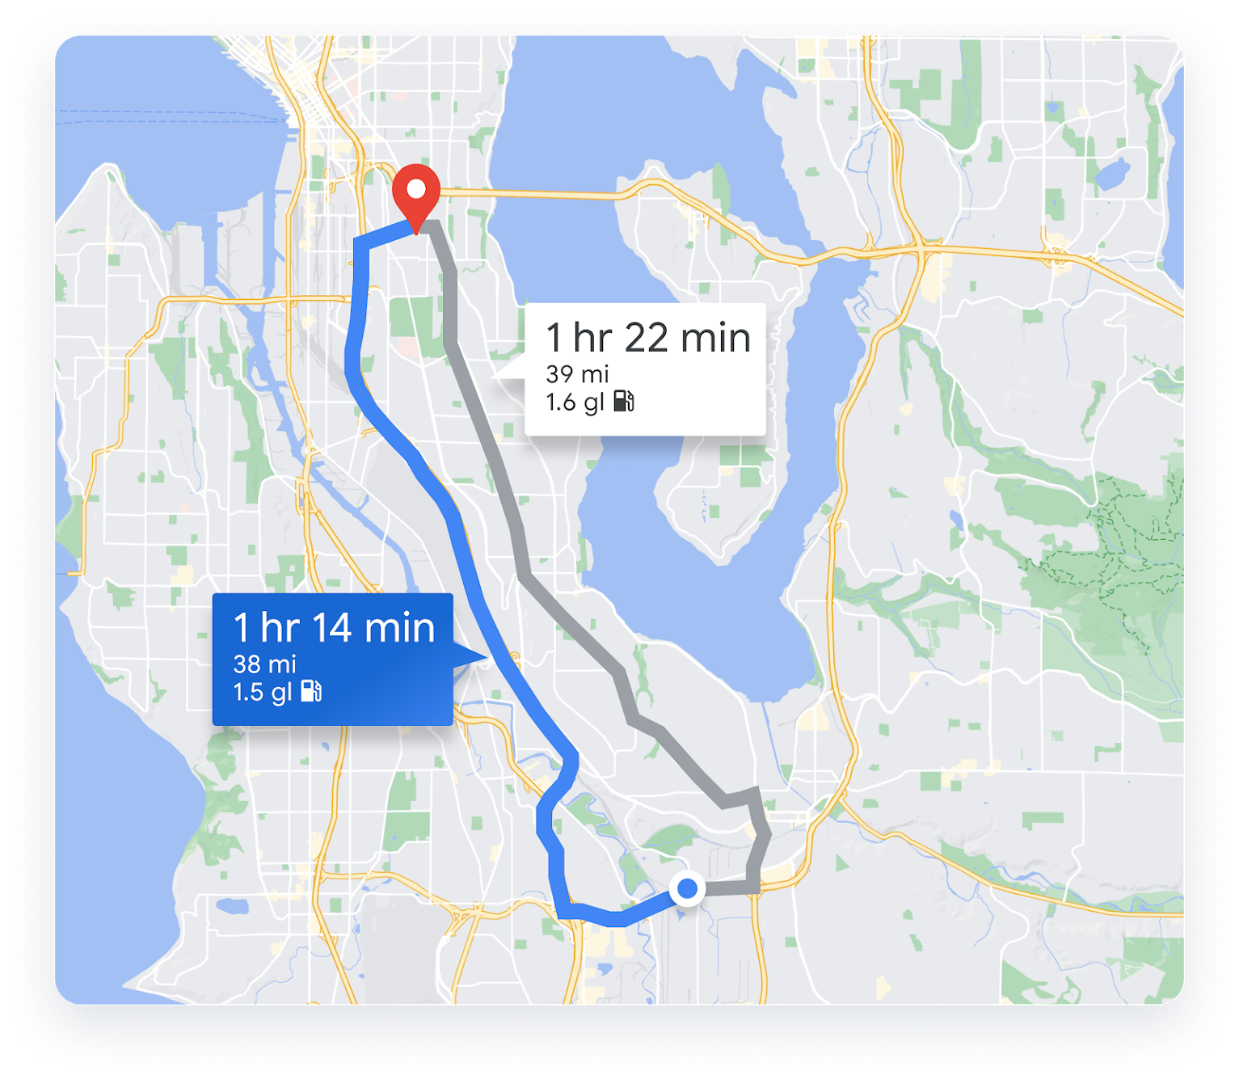

Slide 16
11 Activity 3
Goal: Reach school on time → If it starts raining → ________
Goal: Finish homework before dinner → If the internet goes down → ________
Goal: Stay healthy → If the fridge has only snacks → ________
Goal: Save phone battery → If a video is playing → ________
Goal: Keep room clean → If the floor is messy → ________
Goal: Water plants without wasting water → If it’s raining outside → ________
Goal: Attend online lecture → If Wi-Fi is slow → ________
Goal: Avoid traffic → If the main road is jammed → ________
Goal: Watch favorite show → If someone else is using TV → ________

Slide 17
12 Utility-Based Agent
Tries to maximize happiness / performance / safety.
Handles conflicting goals (speed vs safety).
Example: Delivery drone choosing fastest but safest route.

Slide 18
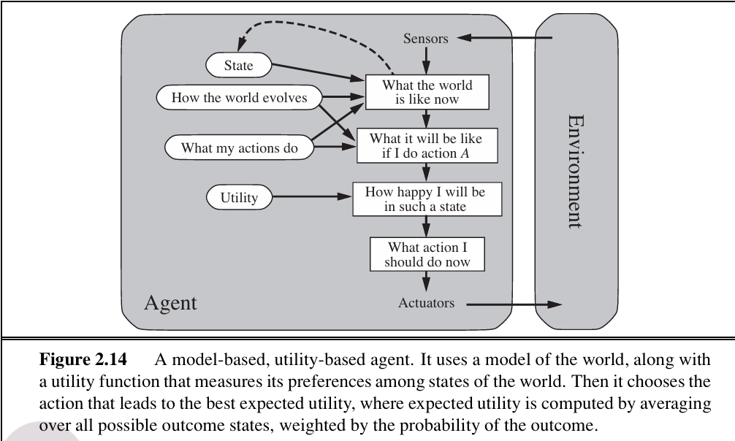

Slide 19
13 Activity 3
You need to go somewhere. You have three route options:
Route | Time | Risk | Utility (Choose the best)
A | 10 min | Risky | ________
B | 15 min | Safe | ________
C | 12 min | Moderate | ________

Slide 20
14 Activity 3
Movie Night (Utility-Based Agent)
Movie | Genre You Like (1–10) | Friends’ Preference (1–10) | Length (hr) | Utility (Fill in)
Movie A | 9 | 5 | 2 | ________
Movie B | 6 | 10 | 3 | ________
Movie C | 7 | 8 | 2.5 | ________

Slide 21
15 Activity 3
Lunch Choice (Utility-Based Agent)
Option | Taste (1–10) | Health (1–10) | Cost (1–10) | Utility (Fill in)
Pizza | 10 | 3 | 5 | ________
Salad | 7 | 10 | 8 | ________
Sandwich | 8 | 7 | 7 | ________

Slide 22
16 Learning Agent
Learning agent improves its performance over time using feedback.
A learning agent can improve with experience. It has 4 components:

Slide 23
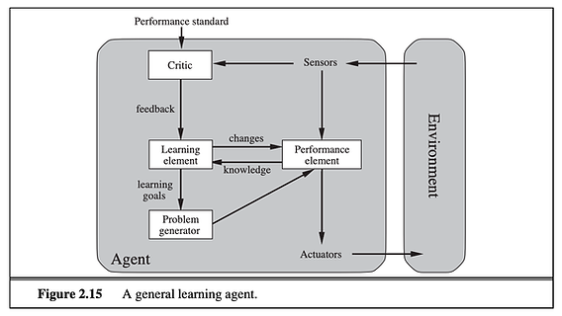

Slide 24
Component | Role | Example
Learning Element (when to use what?) | Improves behavior | Learns smoother braking
Performance Element (How to do everything?) | Acts in environment | Drives car
Critic (Take input of the env and give feedback) | Gives feedback | Scores driving
Problem Generator (Try new things) | Encourages exploration | Tries new route

Slide 25
17 Activity 3
Scenario: The agent has to guess a number between 1 and 10.
Step | Agent Action | Feedback from Environment | How Agent Learns
1 | Guesses 3 | “Too low” | Adjust next guess higher
2 | Guesses 7 | “Too high” | Adjust next guess lower
3 | Guesses 5 | “Correct” | Remember correct number

Slide 26
18 Activity 3
Scenario: Self-Driving Car
Situation | Agent Action | Feedback | Learning Update
Approaching red light | Stop | Success / Safe | Reinforce stop behavior at red lights
Car in front slows down | Brake | Safe distance maintained | Reinforce maintaining safe distance
Obstacle on road | Turn | Avoid collision | Reinforce obstacle avoidance

Slide 27
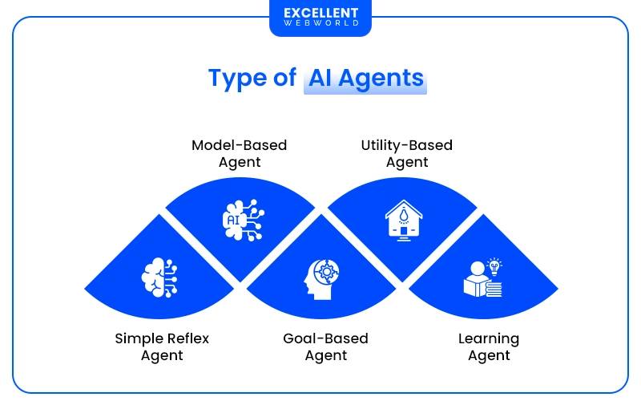

Slide 28
Type | Main Idea | Memory / Model | Example
1. Simple Reflex Agent | Acts only on current percept using condition–action rules | ❌ No memory | Vacuum cleaner → “If dirt → suck”
2. Model-Based Reflex Agent | Keeps an internal state (model of the world) to handle partial observability | ✅ Has model | Self-driving car tracking unseen cars
3. Goal-Based Agent | Chooses actions to achieve goals | ✅ Uses goals + model | Taxi choosing route to destination
4. Utility-Based Agent | Chooses actions that maximize happiness (utility) | ✅ Uses goals + utility function | Taxi choosing safest and fastest route

Slide 29
19 The 6 Core Characteristics of Intelligent Agentst
Rationality (Optimal Choice)
Autonomy (Independence)
Learning & Adaptivity (Growth)
Reactive Behavior (Immediate)
Proactive Behavior (Goal-Driven)
Perception & Action (Eye/Sensor)

Slide 30
Next Class Preview
20
Environment types
The environment is everything an agent interacts with to achieve its goals.

Slide 31

Thank you…

